Slide 1

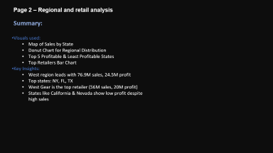
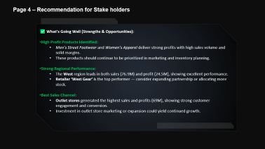
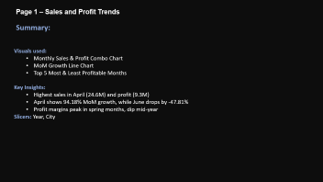
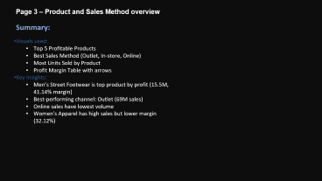


Sales Analytics Dashboard
Sales and Profit Trends
Regional and retail analysis
Product and sales method overview
Recommendation for Stake holders
An Interactive Business Intelligence Report Designed in Power BI Dataset: Sales & Financial Data (Kaggle Source)
By : Mohammed Danish Shaik

Slide 2
Page 1 – Sales and Profit Trends
Summary:
Visuals used:
Monthly Sales & Profit Combo Chart
MoM Growth Line Chart
Top 5 Most & Least Profitable Months
Key Insights:
Highest sales in April (24.6M) and profit (9.3M)
April shows 94.18% MoM growth, while June drops by -47.81%
Profit margins peak in spring months, dip mid-year
Slicers: Year, City

Slide 3
Page 2 – Regional and retail analysis
Summary:
Visuals used:
Map of Sales by State
Donut Chart for Regional Distribution
Top 5 Profitable & Least Profitable States
Top Retailers Bar Chart
Key Insights:
West region leads with 76.9M sales, 24.5M profit
Top states: NY, FL, TX
West Gear is the top retailer (56M sales, 20M profit)
States like California & Nevada show low profit despite high sales

Slide 4
Page 3 – Product and Sales Method overview
Summary:
Visuals used:
Top 5 Profitable Products
Best Sales Method (Outlet, In-store, Online)
Most Units Sold by Product
Profit Margin Table with arrows
Key Insights:
Men’s Street Footwear is top product by profit (15.5M, 41.14% margin)
Best-performing channel: Outlet (69M sales)
Online sales have lowest volume
Women's Apparel has high sales but lower margin (32.12%)

Slide 5
Page 4 – Recommendation for Stake holders
✅ What’s Going Well (Strengths & Opportunities):
High Profit Products Identified:
Men’s Street Footwear and Women’s Apparel deliver strong profits with high sales volume and solid margins.
These products should continue to be prioritized in marketing and inventory planning.
Strong Regional Performance:
The West region leads in both sales (76.9M) and profit (24.5M), showing excellent performance.
Retailer ‘West Gear’ is the top performer — consider expanding partnership or allocating more stock.
Best Sales Channel:
Outlet stores generated the highest sales and profits (69M), showing strong customer engagement and conversion.
Investment in outlet store marketing or expansion could yield continued growth.
⚠️ What Needs Improvement (Weaknesses & Risks):
Underperforming Months:
Months like June and July showed significant MoM drops in sales and profit (e.g., June: -47.81%).
Review seasonal demand, marketing efforts, and supply chain during these periods.
High Sales but Low Profit States:
States like California, Washington, and Nevada show high sales but appear in the least profitable states.
Investigate operational costs, pricing strategy, or product mix in these regions.
Online Channel Underperformance:
Online sales volume lags behind outlet and in-store methods despite overall digital trends.
Consider UX improvements, promotional offers, and SEO/marketing for online platforms.
Profit Margins Vary Widely by Product:
Some high-revenue items have low profit margins (e.g., Men’s Athletic Footwear at ~29%).
Revisit pricing or production costs to enhance profitability.

Slide 6
Page 4 – Recommendation for Stake holders
✅ What’s Going Well (Strengths & Opportunities):
High Profit Products Identified:
Men’s Street Footwear and Women’s Apparel deliver strong profits with high sales volume and solid margins.
These products should continue to be prioritized in marketing and inventory planning.
Strong Regional Performance:
The West region leads in both sales (76.9M) and profit (24.5M), showing excellent performance.
Retailer ‘West Gear’ is the top performer — consider expanding partnership or allocating more stock.
Best Sales Channel:
Outlet stores generated the highest sales and profits (69M), showing strong customer engagement and conversion.
Investment in outlet store marketing or expansion could yield continued growth.
🧠 Strategic Suggestions:
🛠️ Optimize Inventory & Focus on High-Margin Products Focus production and marketing efforts on high-margin, high-performing items.
🌐 Boost Online Sales Through Campaigns Run seasonal promotions, improve website UX, and use retargeting ads to drive more online traffic.
📍 Region-Specific Pricing or Promotions Adjust pricing or promotional efforts in low-profit states to improve margin without hurting volume.
📈 Monitor Sales Trends Monthly Use the dashboard regularly to catch sudden drops or spikes early — and respond faster.
⚠️ What Needs Improvement (Weaknesses & Risks):
Underperforming Months:
Months like June and July showed significant MoM drops in sales and profit (e.g., June: -47.81%).
Review seasonal demand, marketing efforts, and supply chain during these periods.
High Sales but Low Profit States:
States like California, Washington, and Nevada show high sales but appear in the least profitable states.
Investigate operational costs, pricing strategy, or product mix in these regions.
Online Channel Underperformance:
Online sales volume lags behind outlet and in-store methods despite overall digital trends.
Consider UX improvements, promotional offers, and SEO/marketing for online platforms.
Profit Margins Vary Widely by Product:
Some high-revenue items have low profit margins (e.g., Men’s Athletic Footwear at ~29%).
Revisit pricing or production costs to enhance profitability.

Slide 7
Page 4 – Recommendation for Stake holders
✅ What’s Going Well (Strengths & Opportunities):
High Profit Products Identified:
Men’s Street Footwear and Women’s Apparel deliver strong profits with high sales volume and solid margins.
These products should continue to be prioritized in marketing and inventory planning.
Strong Regional Performance:
The West region leads in both sales (76.9M) and profit (24.5M), showing excellent performance.
Retailer ‘West Gear’ is the top performer — consider expanding partnership or allocating more stock.
Best Sales Channel:
Outlet stores generated the highest sales and profits (69M), showing strong customer engagement and conversion.
Investment in outlet store marketing or expansion could yield continued growth.
🧠 Strategic Suggestions:
🛠️ Optimize Inventory & Focus on High-Margin Products Focus production and marketing efforts on high-margin, high-performing items.
🌐 Boost Online Sales Through Campaigns Run seasonal promotions, improve website UX, and use retargeting ads to drive more online traffic.
📍 Region-Specific Pricing or Promotions Adjust pricing or promotional efforts in low-profit states to improve margin without hurting volume.
📈 Monitor Sales Trends Monthly Use the dashboard regularly to catch sudden drops or spikes early — and respond faster.
⚠️ What Needs Improvement (Weaknesses & Risks):
Underperforming Months:
Months like June and July showed significant MoM drops in sales and profit (e.g., June: -47.81%).
Review seasonal demand, marketing efforts, and supply chain during these periods.
High Sales but Low Profit States:
States like California, Washington, and Nevada show high sales but appear in the least profitable states.
Investigate operational costs, pricing strategy, or product mix in these regions.
Online Channel Underperformance:
Online sales volume lags behind outlet and in-store methods despite overall digital trends.
Consider UX improvements, promotional offers, and SEO/marketing for online platforms.
Profit Margins Vary Widely by Product:
Some high-revenue items have low profit margins (e.g., Men’s Athletic Footwear at ~29%).
Revisit pricing or production costs to enhance profitability.

